Slide 1
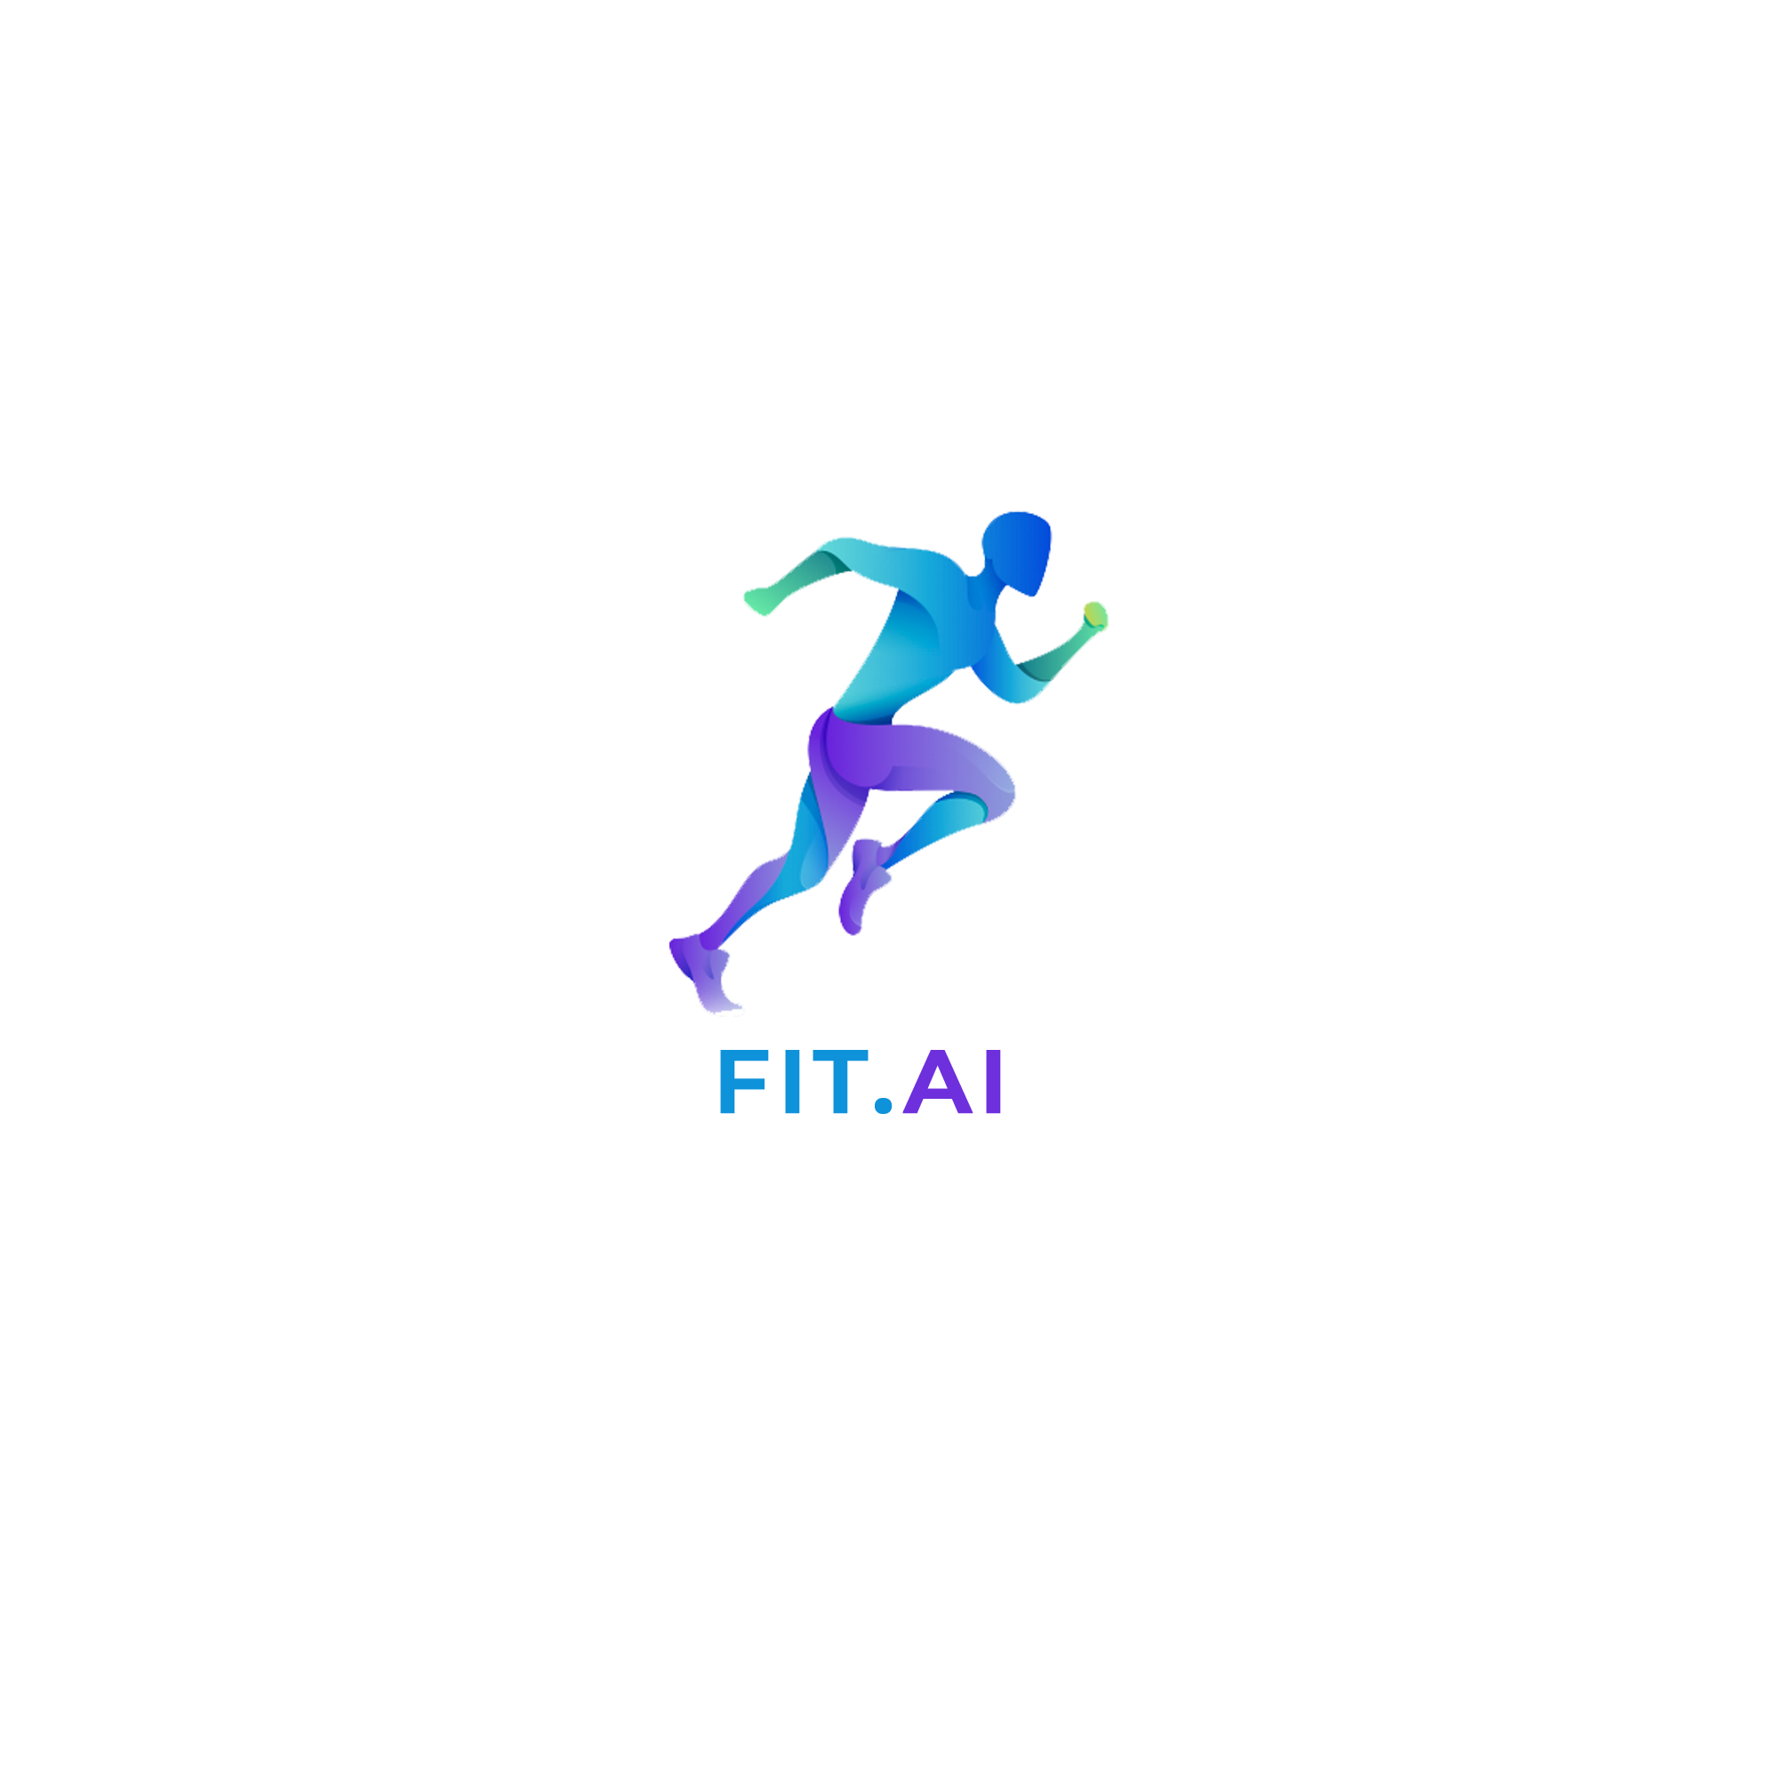
Smarter GYMNASTICS

Slide 2
CURRENT technology
Athletes need time to achieve perfection and mistakes are very difficult to spot and improve upon .
There are high quality coaches and advanced analytics to analyze performance of atheletes but still susceptible to errors.
Injured sportsman struggle to do a comeback because of lack of performance analysis.
Switching to a new trainer is difficult as new trainers need time to analyze a person.
No cheap and efficient Realtime software that helps to understand development of an athlete as time progresses.

Slide 3
Our Idea
Implement a robust tracking system for a human body, which is cheap.
Track the athletes E.g. Gymnasts postures and positions and help him achieve perfection.
Analyze how body of an athlete can be tuned and help him train without a trainer.
Switching trainers made simple, New trainer can have analysis ready at his sight.
Comeback from injury is simple, we can have record of previous performance which helps to analyze fitness.
Help to reduce injury chances as well.

Slide 4
Why we need THIS ?
Too difficult even for a expert to spot difference. (watch https://www.youtube.com/watch?v=MQVxhgdzI2U&t=30s)
Hard to understand mistakes without a detailed analysis of body tracking.
Little difference in movement can cause lot of effects.
More important to analyse the key weakness areas, which are not easily spotable.
Accurate, reliable and trusted platform required.

Slide 5
How we analyse ? Our usp…
Generate accurate real-time tracking.
Consists of IoT + Deep Learning techniques to provide precise detection.
Real-time, dashboard data, solves the major problem of performance history.
Switching coaches ? Very simple, can improve on specific areas, need not re-analyse.
Track monthly progress, help to recover from injuries using key difference in performance.
Can be have very creative approach towards new postures.

Slide 6
Our Implementation PLAN
Implement 2D posture analysis.
Using IoT to get the exact coordinates.
Test on Real Gymnast video which is working to provide 15 keypoint analysis.
Provide a Graph Analysis of Postures which accurately describes how and where improvements can be made.
Provide details of mistakes of a person in performance. Track the improvements in weak areas.
Assses injuries faster, help to realise if player is fully fit using sensors.

Slide 7
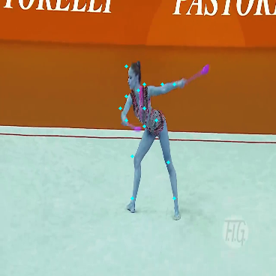
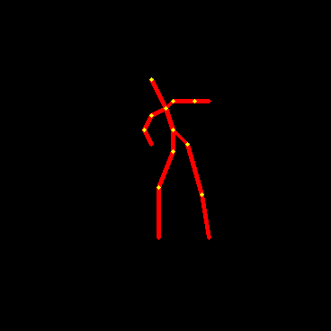
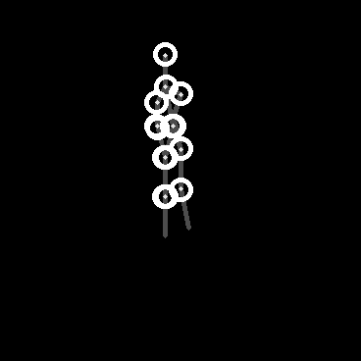
Sample work done till now

Slide 8
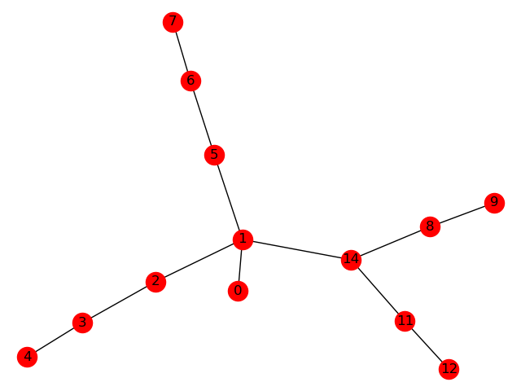
Now resolving INTO Simple Graph decomposition
Now we can easily do a graph angle analysis for joints.
Can find the constant weakest point in graph.
Innovative graph algorithms can be designed for the given product.

Slide 9
Confidence in our product
Technically sound. We have used proper Deep Learning based accurate methods.
Tracking with known CV Algorithms which can be optimized further for specific sports required.
Given a sufficient dataset and more posture and graphs to analyse, it will get accurate and better.
Currently with minimum costing around 2000 Rs. We have achieved significant performance gain.

Slide 10
Effective revenue model
Target Audience: - Small to Big sport academies .
How to cover variety of crowd under one hood and yet provide cutting edge results ?
Provide version!!
Highly advanced DL models and more accurate sensor tracking for enterprise level.
Lower level models which run faster but less accurate, but good enough for beginners.
Scale the product according to realtime needs, quality of analysis and personalized training applications

Slide 11
FUTURE SCOPE AND FURTHER IMPLEMENTATION
Provide a 3D modelling using AR.
Live simulation of the person which provides a more real-time video rendering.
Using IoT we can track more exact location and accurate coordinates.
Provide smaller sensors, which are more easily wearable and portable.
Live posture analysis which can show immediate and prompt results.

